Slide 1

Clostridium difficile
Jennifer Clark

Slide 2
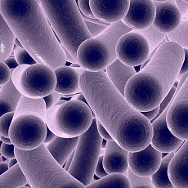
C. difficile or C. diff
-Clostridium difficile (C. difficile) is a bacterium that can cause diarrhea and more serious intestinal conditions such as colitis.
-C. diff causes close to half a million illnesses each year and can affect people of all ages.
About 1 in 6 patients who get C. diff
will get it again in the subsequent
2–8 weeks.

Slide 3

C. diff risk factors
Most commonly occur when taking antibiotics
Extended stays in healthcare settings especially in hospitals and nursing homes
Weakened immune system
Previous infection with C.diff
Notes:
The reason C. diff mostly occurs when taking antibiotics is because antibiotics affect your microbiome by wiping out bad germs but also the good germs that protect your body against infections. The effect of antibiotics can last as long as several months. If you come in contact with C. diff germs during this time, you can get sick.

Slide 4
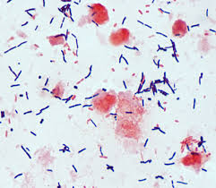
Clostridium difficile
Kingdom: Bacteria
Phylum: Firmicutes
Class: Clostridia
Order: Clostridiales
Family: Clostridiaccae
Genus Species: Clostridium

Slide 5
Type of Microbe
Clostridium difficile is a:
Bacteria
Gram positive
Rod shaped
Spore-forming

Slide 6
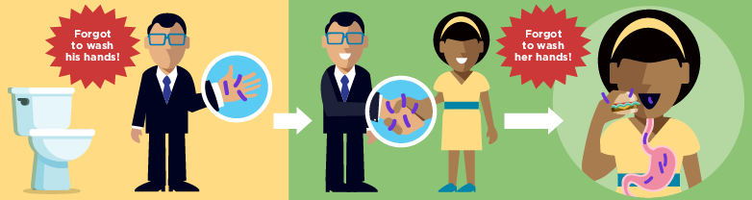
1. Preferred portal of entry
Digestive, mouth
2. Route of transmission
Fecal oral ingestion
3. How does it leave the host?
            Difficile bacteria are passed in feces
Notes:
C. difficile bacteria and their spores are found in feces. People can get infected if they touch surfaces contaminated with feces, and then touch their mouth. Healthcare workers can spread the bacteria to their patients if their hands are contaminated.

Slide 7

The first step in treating C. difficile is to stop taking the antibiotic that triggered the infection, when possible.
Depending on the severity of your infection, treatment may include:
Antibiotics
Surgery
Notes:
Antibiotics- Ironically, the standard treatment for C. difficile is another antibiotic. These antibiotics keep C. difficile from growing, which in turn treats diarrhea and other complications. Your doctor may prescribe vancomycin (Vancocin HCL, Firvanq) or fidaxomicin (Dificid).
Surgery- For people who have severe pain, organ failure, toxic megacolon or inflammation of the lining of the abdominal wall, surgery to remove the diseased portion of the colon may be the only option.

Slide 8

Prevention
Improving the way they prescribe antibiotics.
Using the tests that give the most accurate results.
Rapidly identifying and isolating patients with C. diff.
Wearing gloves and gowns when treating patients with C. diff—and remembering that hand sanitizer doesn’t kill C. diff.
Cleaning surfaces in rooms where C. diff patients are treated with EPA-approved, spore-killing disinfectant.
Notes:
Health care workers should practice good hand hygiene before and after treating each person in their care. In the event of a C. difficile outbreak, using soap and warm water is a better choice for hand hygiene, because alcohol-based hand sanitizers don't effectively destroy C. difficile spores. Visitors also should wash their hands with soap and warm water before and after leaving the room or using the bathroom.
People who are hospitalized with C. difficile have a private room or share a room with someone who has the same illness. Hospital staff and visitors wear disposable gloves and isolation gowns while in the room.
In any health care setting, all surfaces should be carefully disinfected with a product that contains chlorine bleach. C. difficile spores can survive exposure to routine cleaning products that don't contain bleach.

Slide 9

I have been working in a hospital for over 5 years now and I hear about this disease all too often. Aspiring to be a nurse, I wanted to become more informed about this highly contagious disease and how I can better prevent the spread for the safety of everyone.

Slide 10

Centers for Disease Control and Prevention. (2018). Your Risk of C.diff. Available at : https://www.cdc.gov/cdiff/risk.html
Mayo Clinic. (2019). C. difficle infection. Symptoms and causes. Available at:
https://www.mayoclinic.org/diseases-conditions/c-difficile/symptoms-causes/syc-20351691
Mayo Clinic. (2019). C. difficile infection. Diagnosis and treatment. Available at: https://www.mayoclinic.org/diseases-conditions/c-difficile/diagnosis-treatment/drc-20351697
Medlineplus.gov. (2019). Clostridium Difficile Infections: MedlinePlus. Available at :
https://medlineplus.gov/clostridiumdifficileinfections.html

